Slide 1
Step Tracing Programs
The Debugger

Slide 2
When programs compile, but…
Step-tracing using the debugger will help find logical errors in a program.
A break-point can halt a programs execution at a certain command, allowing the programmer to execute the code one line at a time.
A variable watch will track the state of primitives and objects as the program runs.

Slide 3
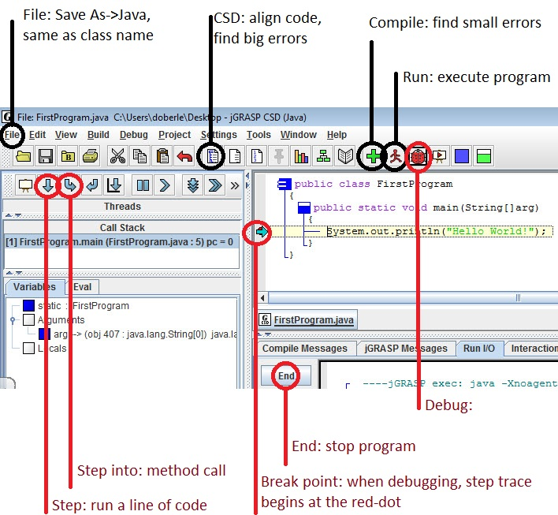

Slide 4
Debugging
Insert a break point at the spot where you want to start the step-trace.
- left click to toggle a red-dot on the left
side of the editor window
2) Run the debugger.
- red bug icon to the right of the run icon
3) Step through the code, or step-into a method when necessary.
- down arrow below the save icon
- watch the variables state in the variables window

